Slide 1


Slide 2
Java Framework
Java Framework is a collection of predefined classes and functions that is used to process input, manage hardware devices, interact with the system software etc.
Framework provides basic structure of your application ( Angular, Spring, Spring Boot, hibernate etc..)
Tools help us to develop our application (Maven , Gradle etc.)

Slide 3
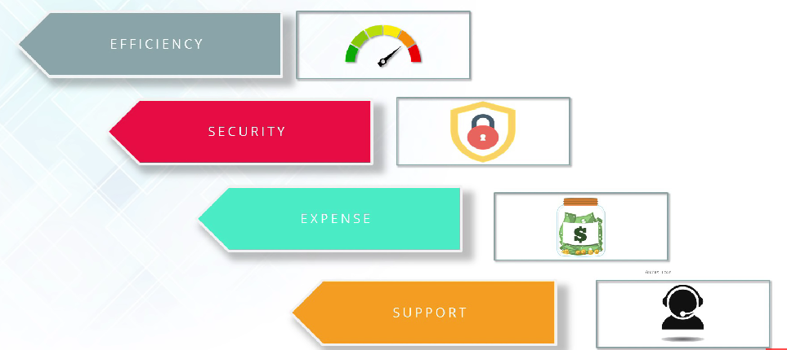
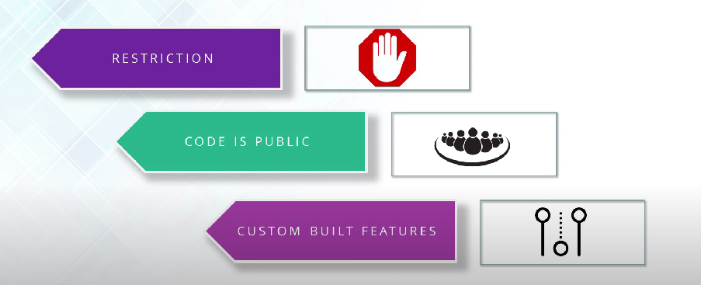
Advantages & Disadvantages
Efficiency
Security
Expense
Support
Restriction
Code is Public
Custom Built Features

Slide 4
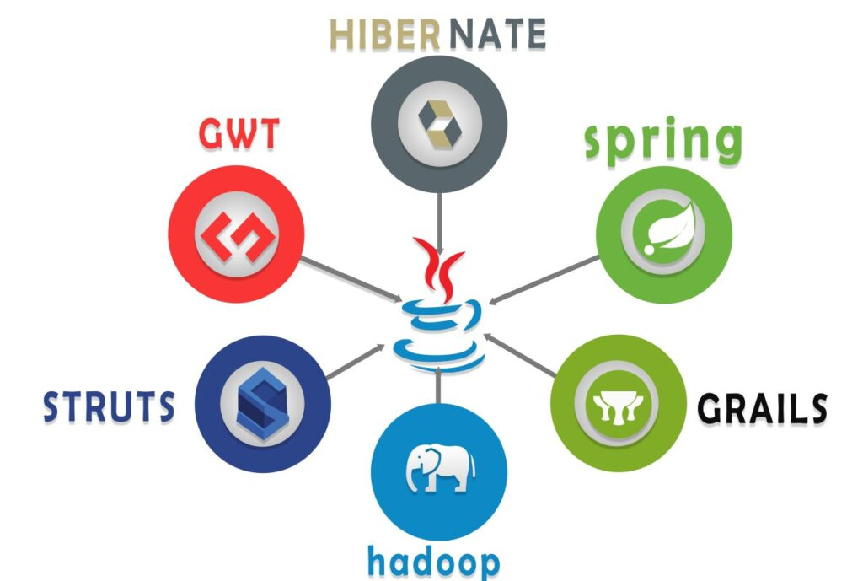
Various Java Frameworks

Slide 5
Spring Framework
Spring is the most popular application development framework for enterprise java.
Open Source Java Platform since 2003.
Spring supports all major application servers and JEE standards.
Spring handles the infrastructure , so that you can focus on your application.

Slide 6
Features Of Spring Framework
Open Sources
Comprehensive Tool
Light Weight
Solves Problems
Framework of Framework
Avails array of resources

Slide 7
Thankyou !

